Slide 1

bioinformatics.ca
bioinformaticsdotca.github.io

Slide 2



Module 3: Data Visualization
<Han Yu>
INTRODUCTION TO R
October 1st-2nd, 2025

Slide 3
Learning Objectives
Enhance Interpretability: Use transformations and faceting for better comparisons
Improve Clarity: Customize aesthetic to effectively communicate insights
Boost Engagement: Create interactive visualizations with plotly
Optimize Storytelling: Select the right plot types for your analysis

Slide 4
Outline
Brief Review of Basic Visualization in R
Why use ggplot 2
Structure of a ggplot2 command
Advanced Customization and Data Transformation
Data transformations and faceting
Customizing ggplot2 plots
Exercise 1
Advanced Visualization Techniques
Specialized plots
Introduction to interactive and dynamic visualizations
Exercise 2

Slide 5
Why Use ggplot2 Over Base R for Data Visualization?
With better aesthetic and higher efficiency
Feature | ggplot2 | Base R
Design Framework | Based on Grammar of Graphics, enabling layered construction | Procedural approach, harder to modify and extend
Customization | Themes and formatting (theme_*) for professional aesthetics | Requires manual adjustments using par() or axis()
Faceting | Built-in with facet_wrap() and facet_grid() | Requires manual layout setup
Syntax | Consistent and modular, easy to learn and maintain | Fragmented and less intuitive
Data Transformations | Directly supports scaling and slicing in plots | Preprocessing required before visualization
Multi-layered Plots | Allows layering of multiple plot types and elements | Complex to achieve with overlays
Interactivity | Seamless integration with interactive packages like plotly | Requires external packages with complex workflows

Slide 6
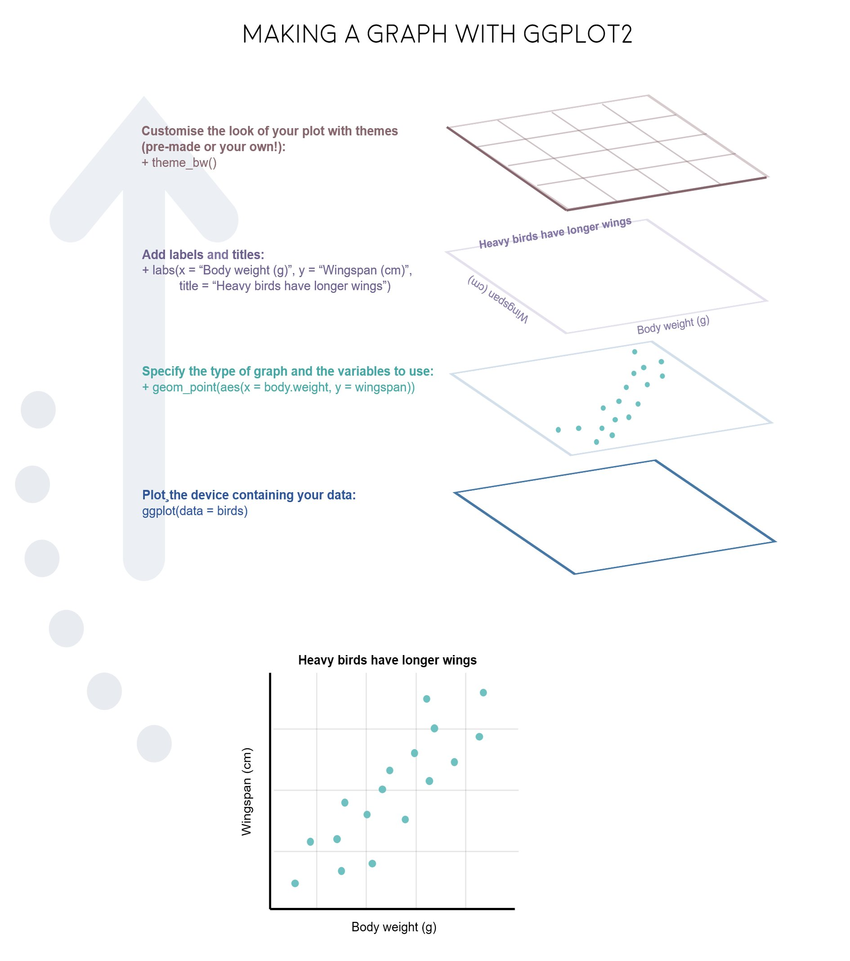
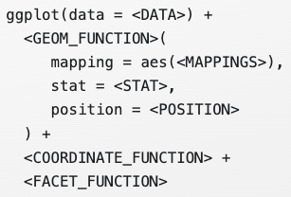
Overview of ggplot2
gg = “grammar of graphics”
Components in ggplot2:
Data
Aesthetic attribute (Aes)
Geometric object (Geom)
Stats
Position
Coord
Facet
Theme
……

Slide 7
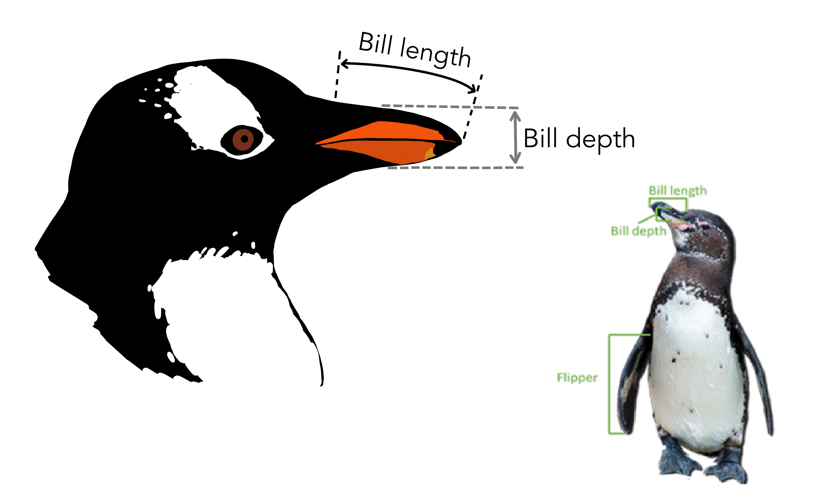
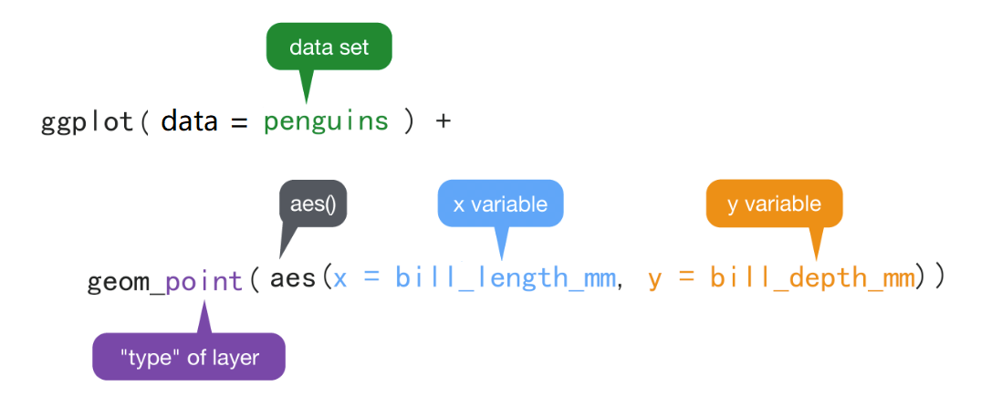
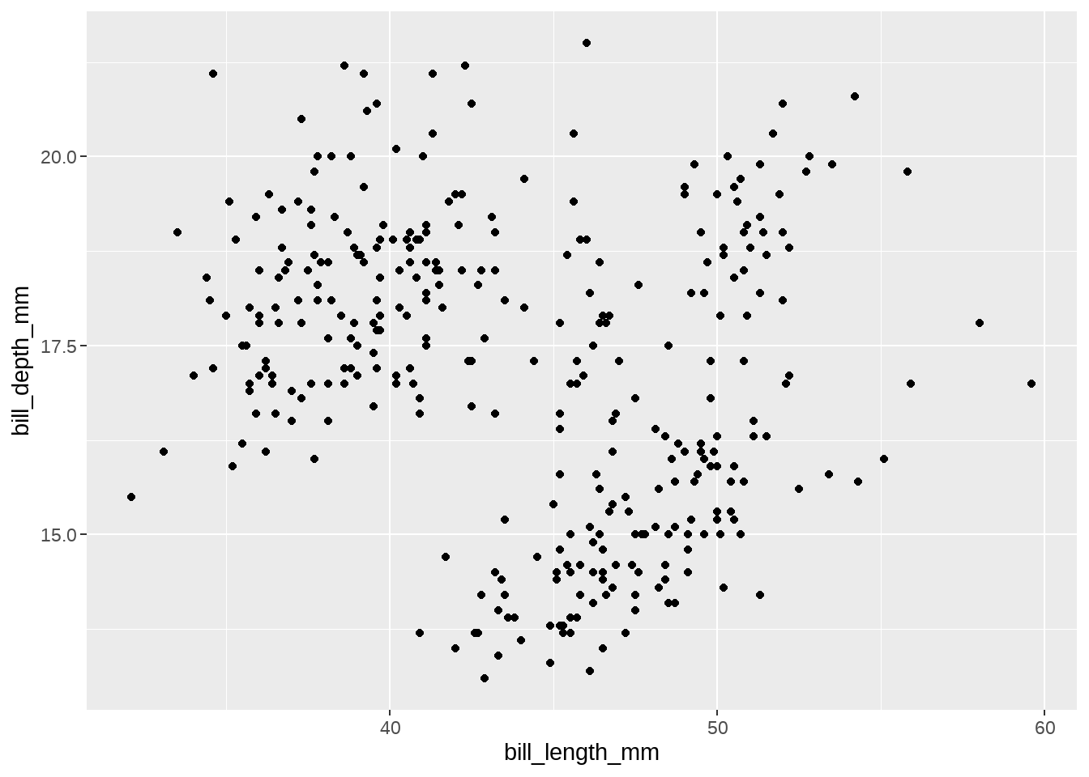
Structure of the ggplot2 command
Question:
The relationship between the bill length and bill
depth of the penguin?

Slide 8
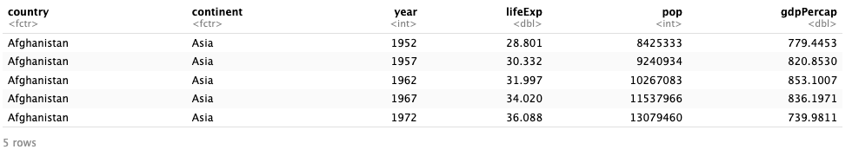
Dataset preparation
gapminder
1704 observations
6 variables
Country: a factor with 142 levels
Continent: a factor with 5 levels
Year: going from 1952 to 2007 in increments of 5 years
Pop: population
gdpPercap: GDP per capita
lifeExp: life expectancy

Slide 9
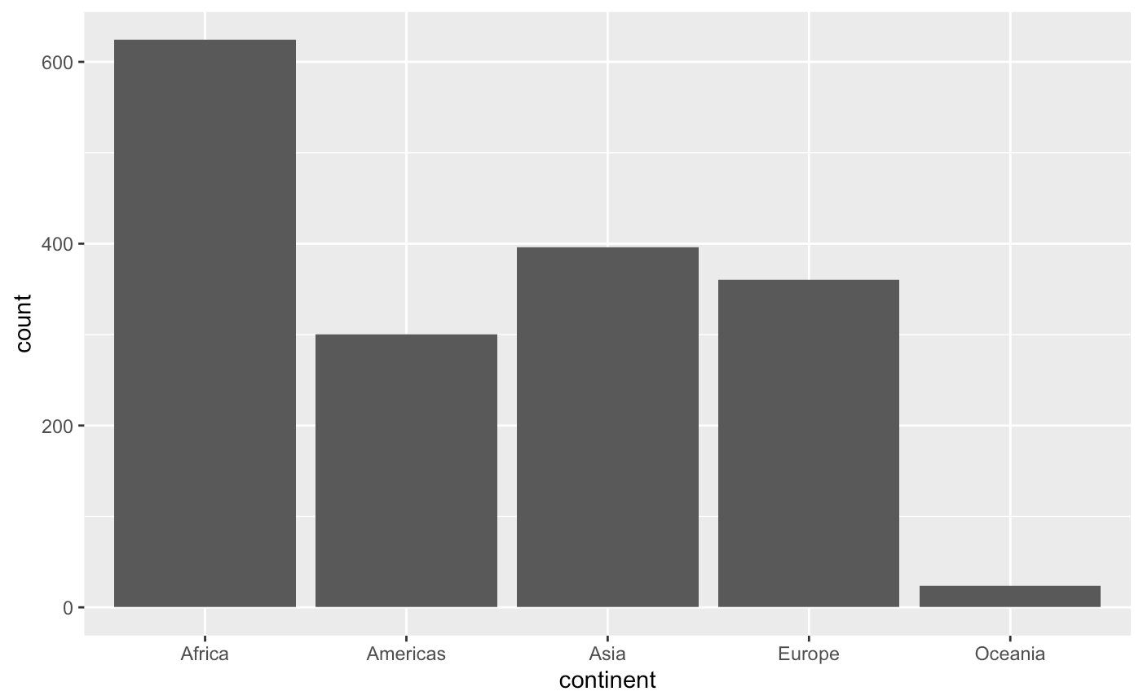
Bar plot
discrete variable
ggplot(gapminder, aes(x = continent)) + geom_bar()
Research Question:
How is the number of recorded observations distributed across different continents?

Slide 10
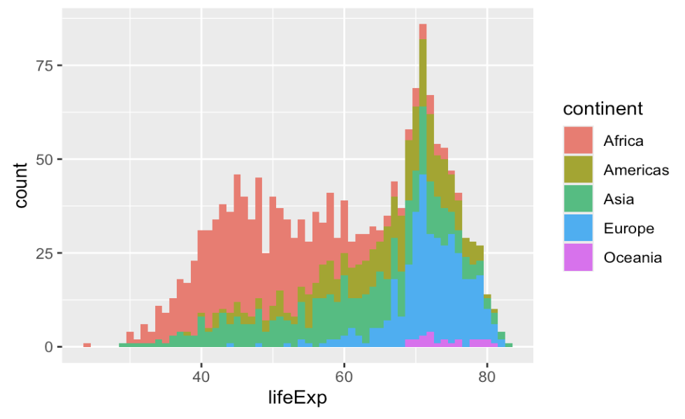
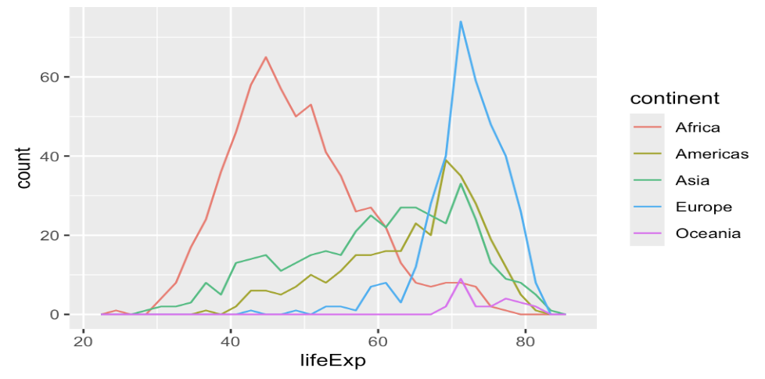
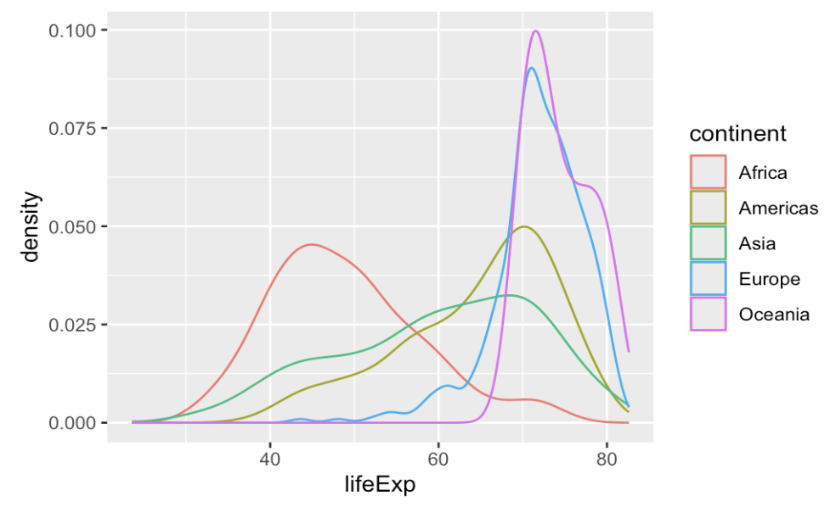
Histogram/ Frequency/ Density Plot
Choosing the right plot
To see raw counts and distribution shape -> Histogram
To compare multiple groups without overlap issues -> Frequency
To observe smoothed probability distributions and peaks -> Density
ggplot(gapminder, aes(x = continent)) +
geom_freqpoly()
ggplot(gapminder, aes(x = continent)) +
geom_density()
ggplot(gapminder, aes(x = continent)) +
geom_histogram(binwidth = 1)
Does the distribution of life expectancy in a continent suggest the presence of two distinct groups?
What is the overall distribution of life expectancy?
Compare the life expectancy across different continents

Slide 11
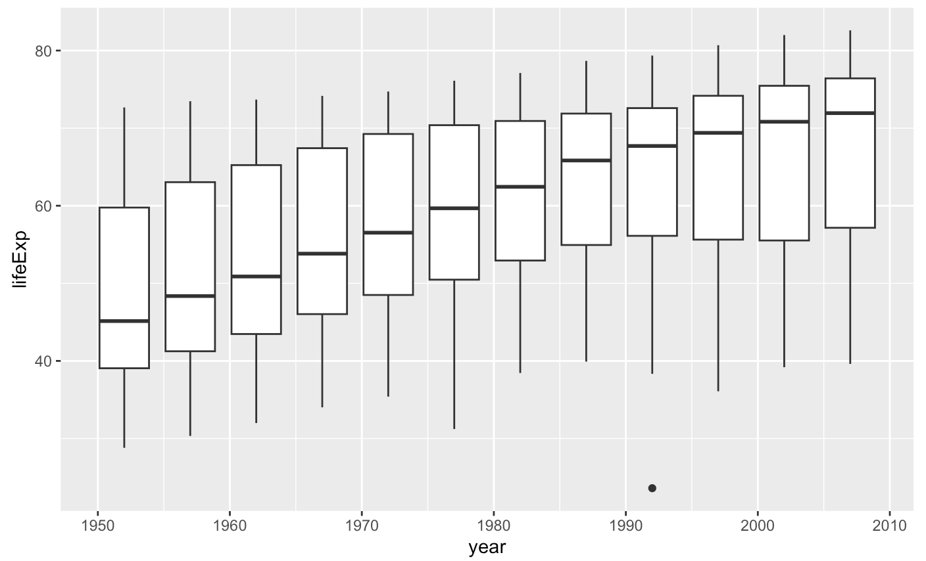
Box plot
one discrete variable + one continuous variable
ggplot(gapminder, aes(x = year, y = lifeExp)) + geom_boxplot(aes(group = year))
Research Question:
How has life expectancy changed over time?

Slide 12
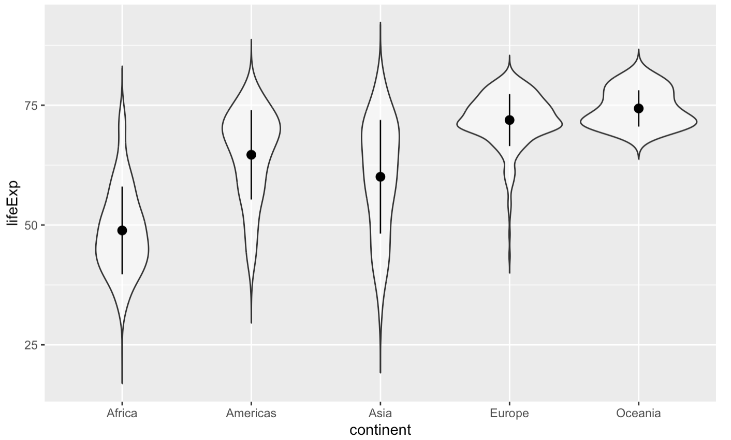
Violin plot
A combination of a box plot and a density plot
ggplot(gapminder, aes(x = continent, y = lifeExp)) + geom_violin(trim = FALSE, alpha = 0.5)
Research Question:
How does the distribution and variability of life expectancy differ across continents?

Slide 13
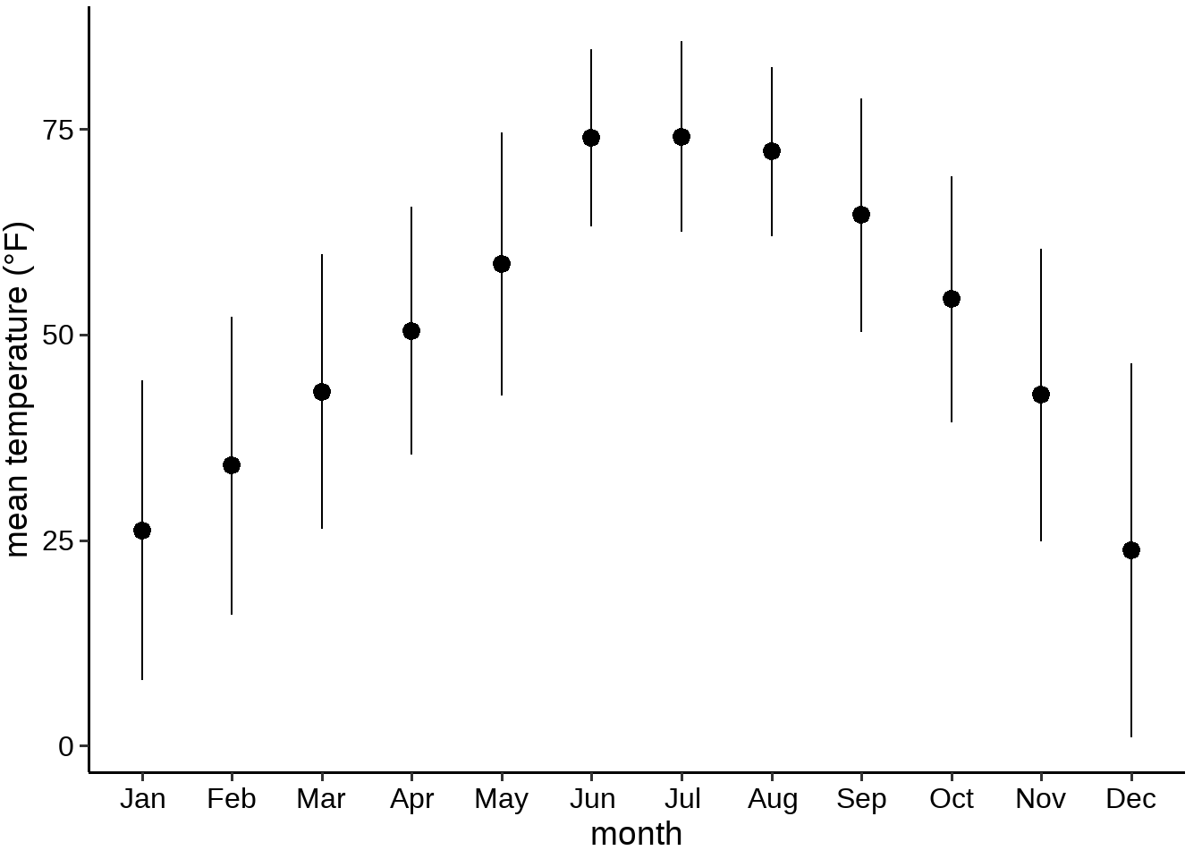
What questions do you have about this plot?

Slide 14
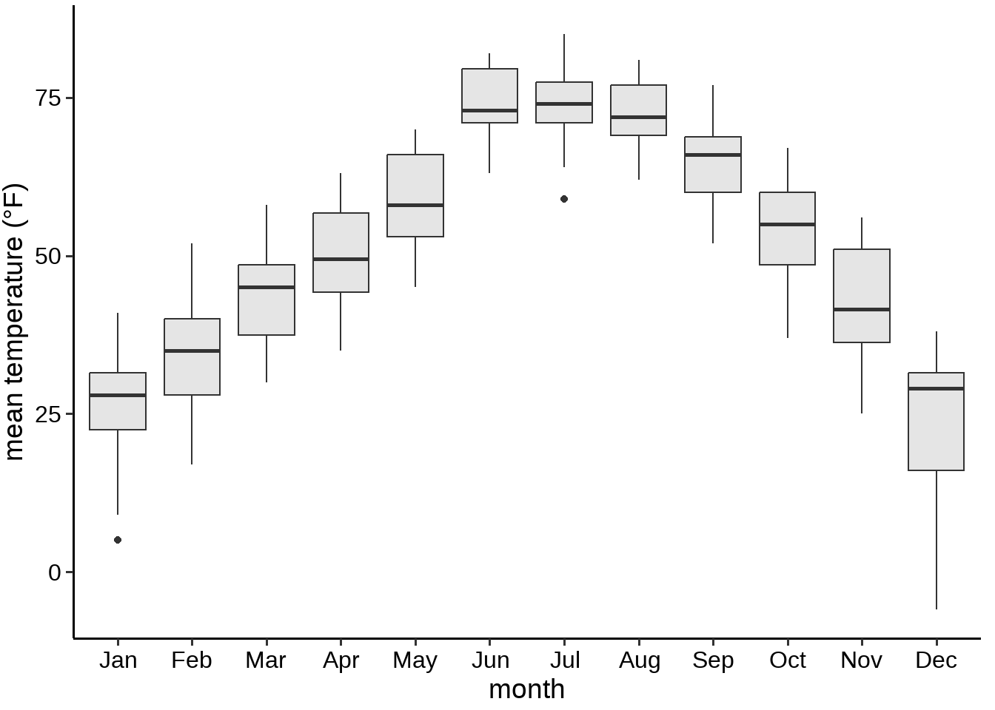
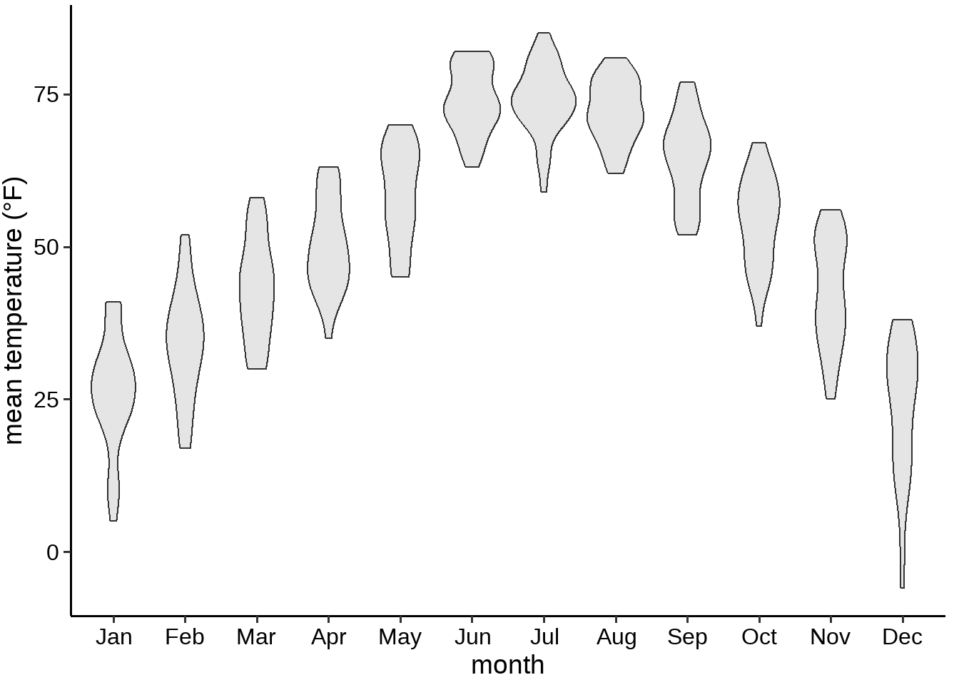
Next step: box/violin plot to show the distribution
What is the problem of the violin or box plot?

Slide 15
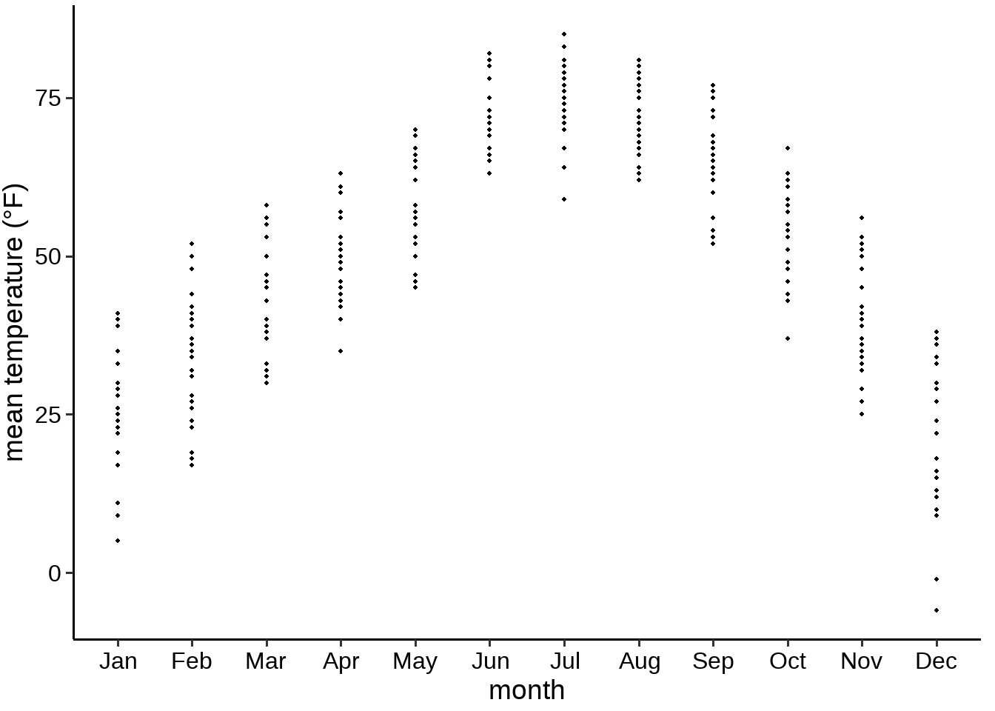
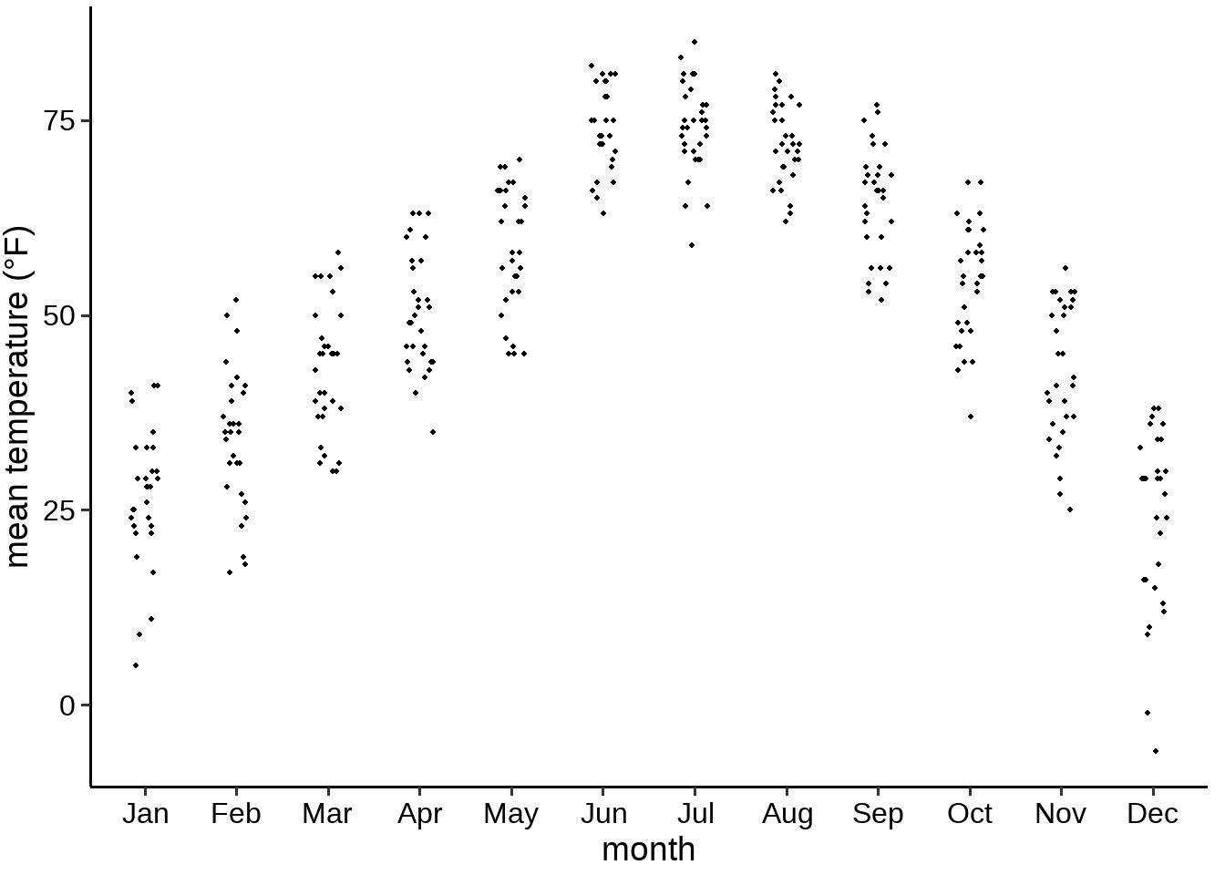
Show raw data points

Slide 16
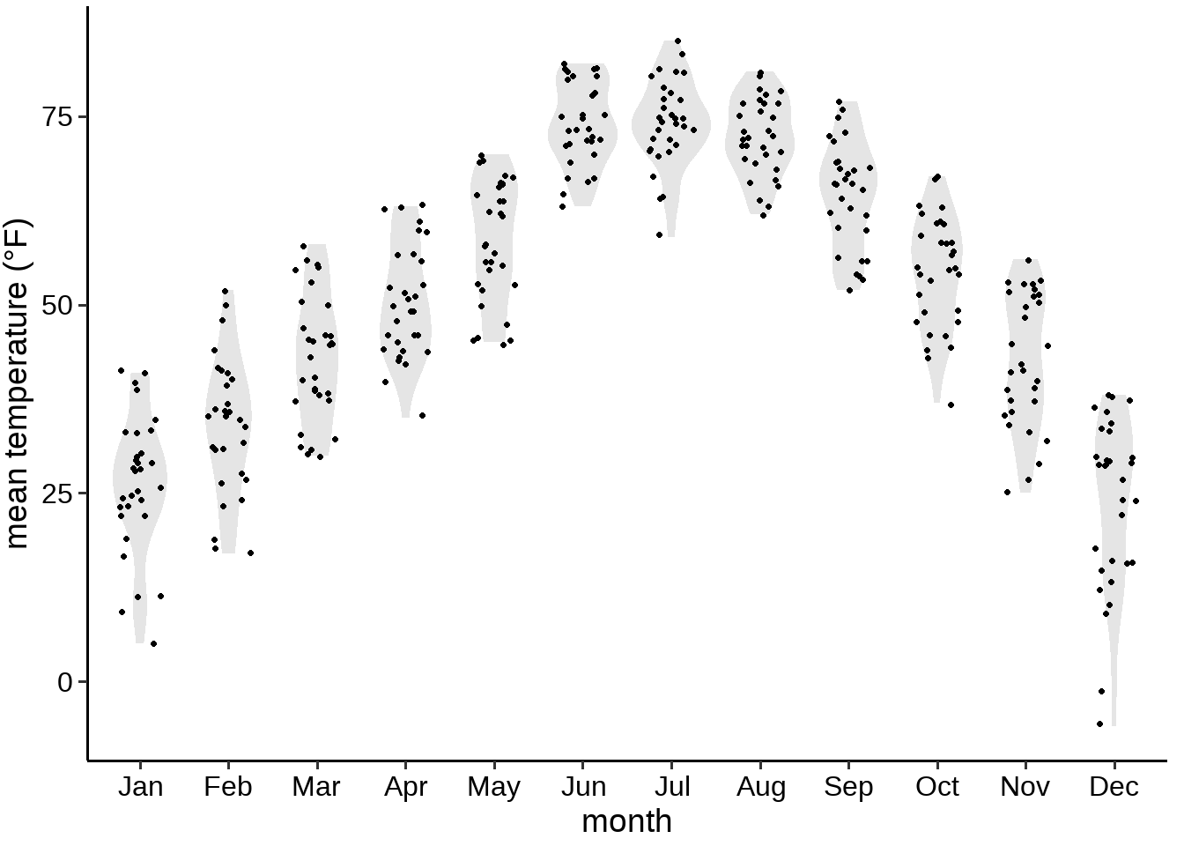
Before and after plots

Slide 17
Data Transformation and Advanced Customization

Slide 18
Data Transformation
 | Why? | functions
Data reshaping | useful for faceting or grouping variables | tidyr::pivot_longer() tidyr::pivot_wider()
Filtering rows and select columns | To focus on relevant data for a clearer visualization. To remove noise or unnecessary categories. | dplyr::filter() dplyr::select()
Aggregation and summarization | Transforming raw data into summarized statistics for better visualization. | dplyr::group_by() dplyr::summarize()
Normalization and scaling | Adjusting numerical values to ensure fair comparisons. Log transformation Min-max scaling Z-score standardization | dplyr::mutate() scale_x_log10()
Binning (Discretization) | Dividing a continuous variable into discrete categories to visualize distributions more clearly (e.g., in histograms or heatmaps). | dplyr::mutate()

Slide 19
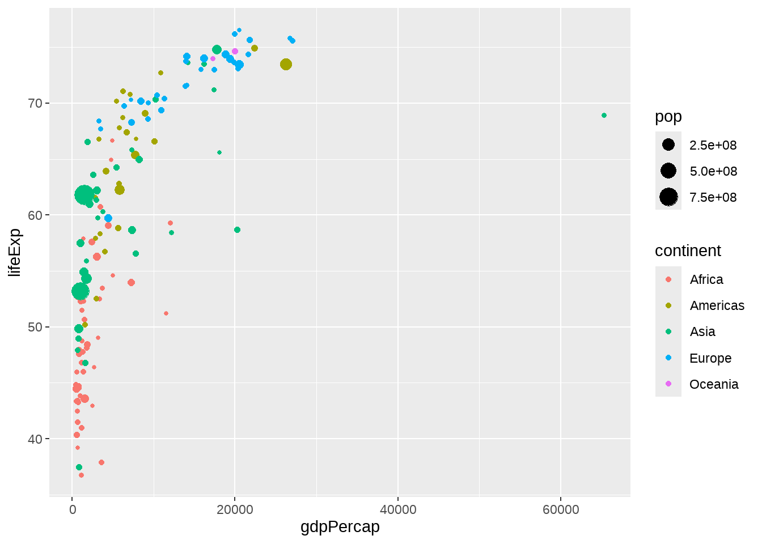
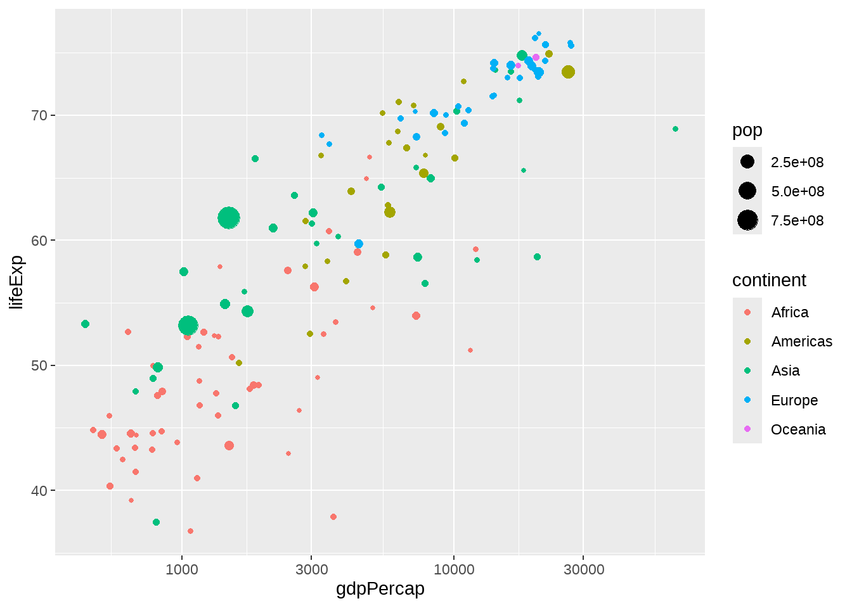
Data Transformation – log transformation
Research Question: How does GDP per capita relate to life expectancy across different continents?
+ scale_x_log10()

Slide 20
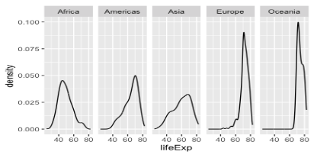
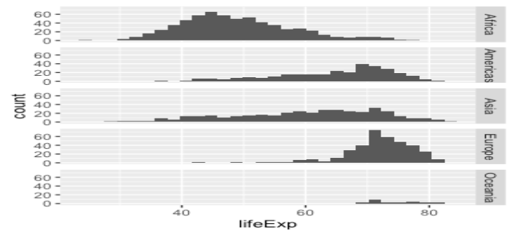
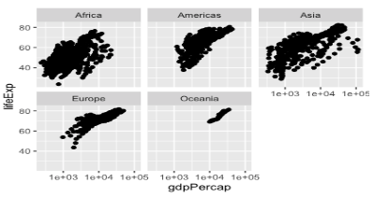
Data faceting
+ facet_grid(. ~ continent)
+ facet_grid(continent ~ .)
Facet_grid()
create a grid of graphs, by rows and columns
+ facet_wrap(~continent)
Choose grid:
Compare categorical variables systematically
The number of facet levels is not too large
Choose wrap:
Flexible and space-efficient
Facet_wrap()
create small multiples by “wrapping” a series of plots

Slide 21
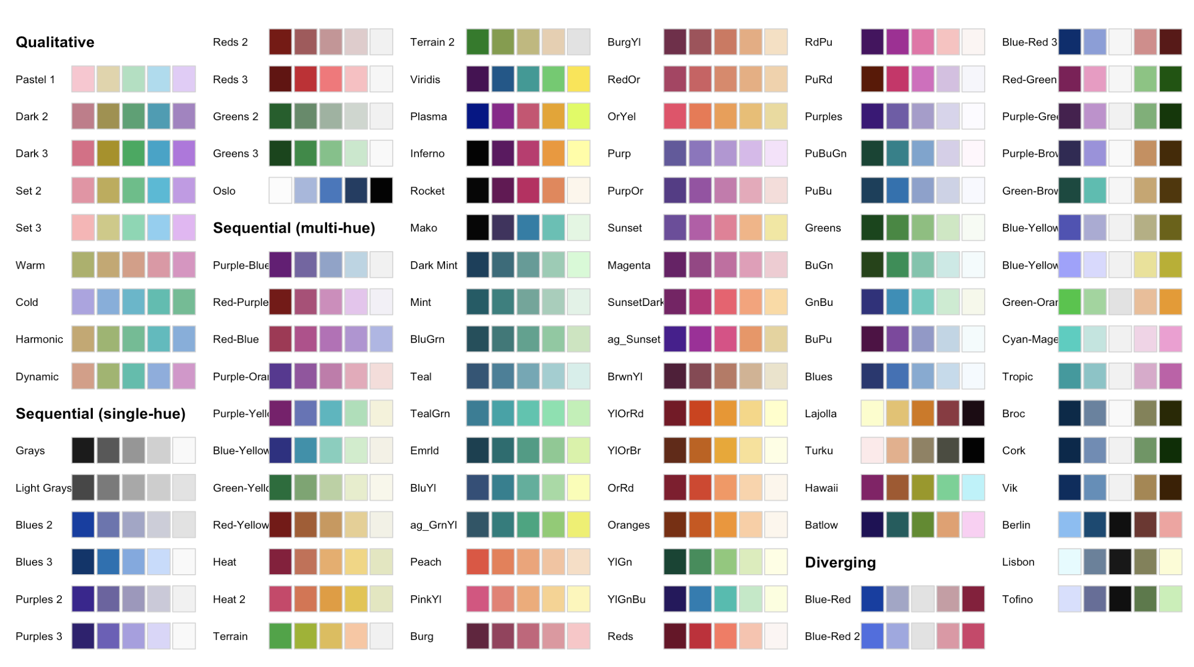
Aesthetic customizations – color palettes
colorspace
Qualitative: categorical variables
qualitative_hcl()
Sequential: ordered/continuous numerical variables
sequential_hcl()
Diverging: ordered/continuous numerical variables
diverging_hcl()
Don’t use bidirectional (diverging) color scales for unidirectional data!

Slide 22
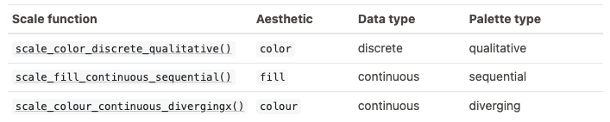
How to use colorspace in ggplot2
scale_<aesthetic>_<datatype>_<colorscale>()

Slide 23
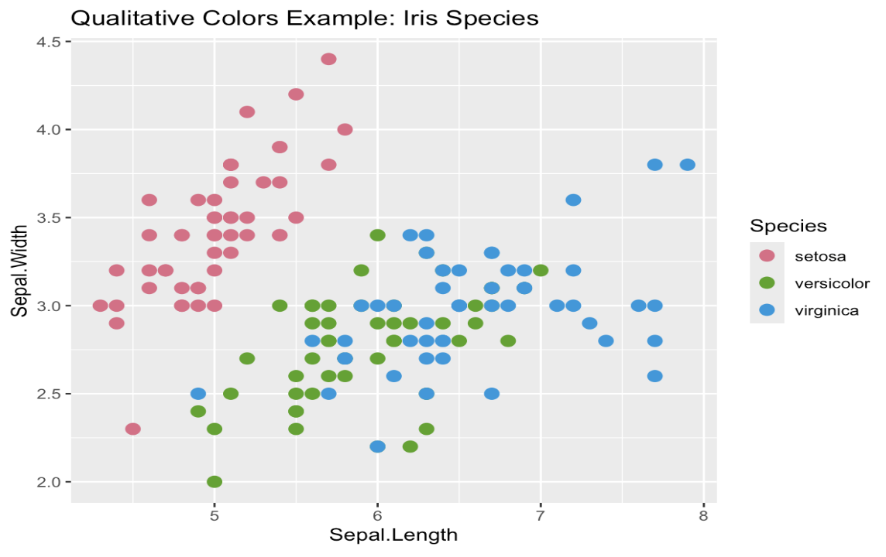
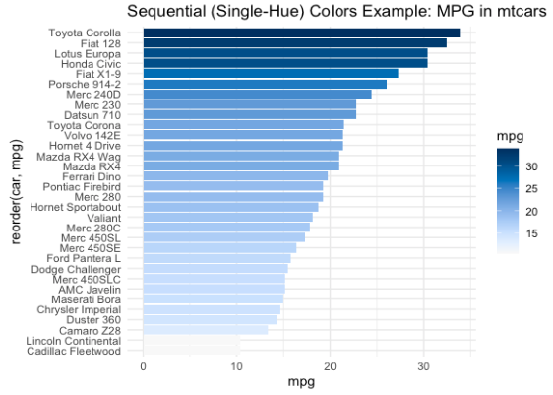
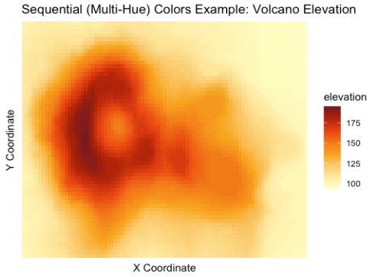
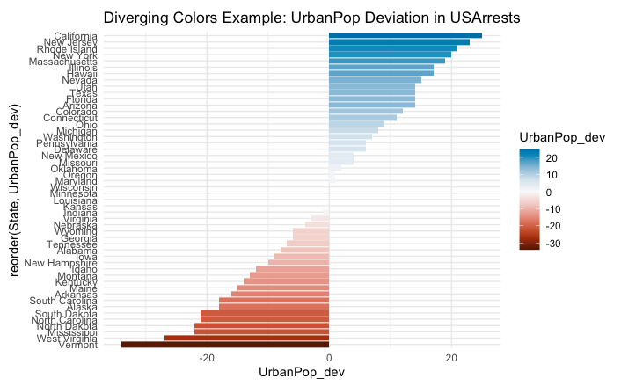
Colorspace examples

Slide 24
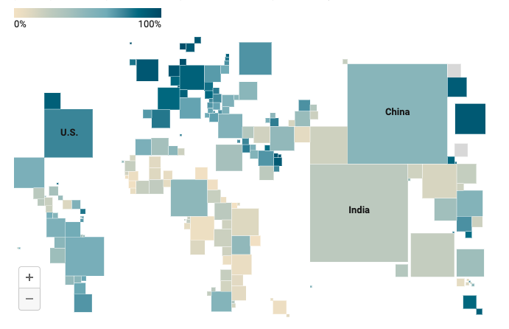
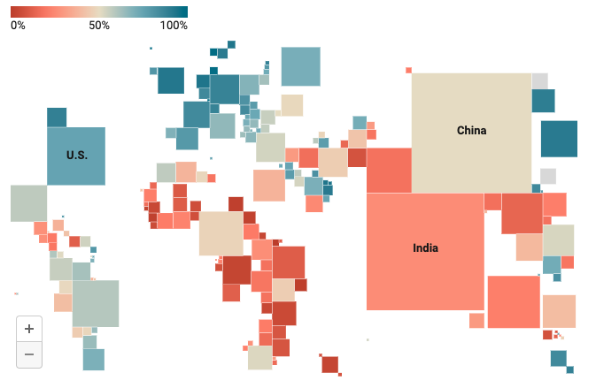
How to choose diverging and sequential color scale?
Use diverging shades if there’s a meaningful middle point
Use diverging shades to emphasize the extremes
Use diverging shades to let readers see more differences in the data
https://blog.datawrapper.de/diverging-vs-sequential-color-scales/

Slide 25
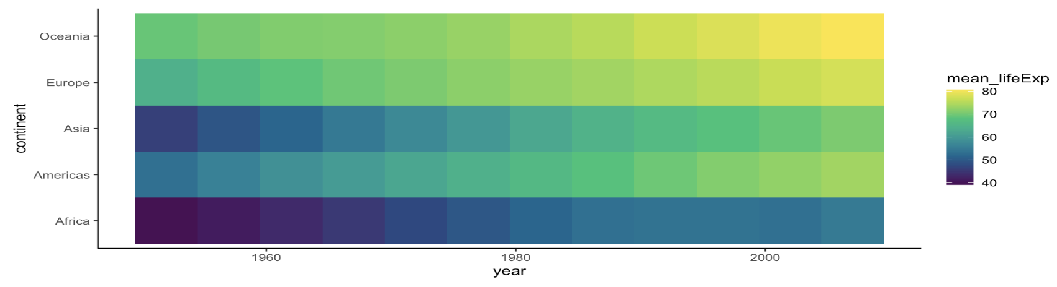
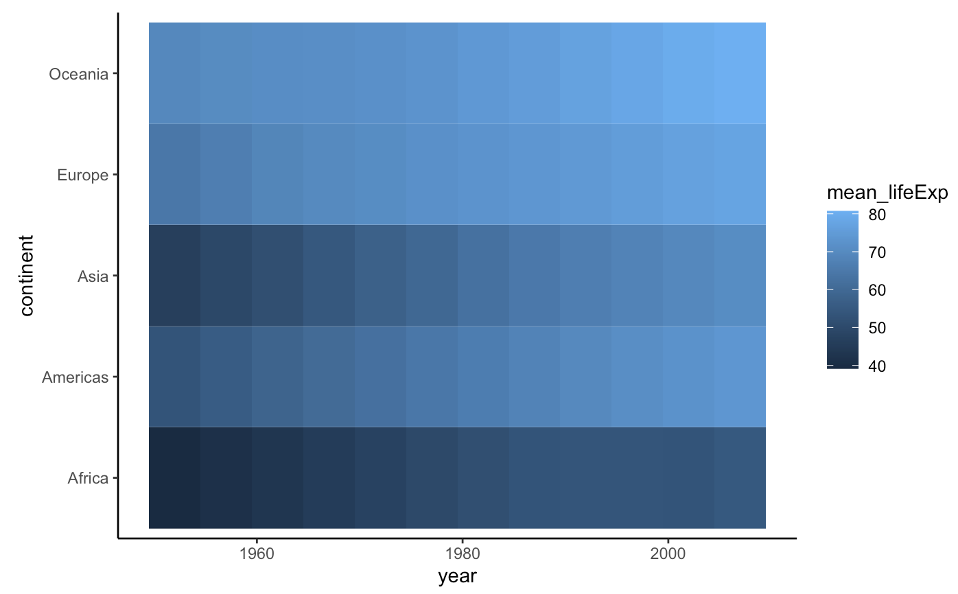
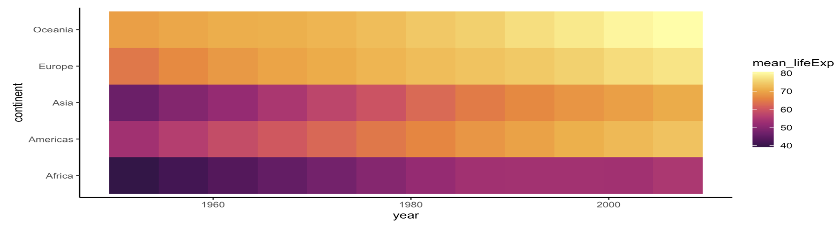
Select the appropriate color palettes for heatmaps
scale_fill_continuous_sequential(palette = "Viridis", rev = FALSE)
scale_fill_continuous_sequential(palette = ”Inferno", rev = FALSE)

Slide 26
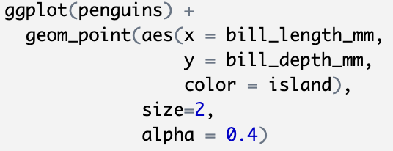
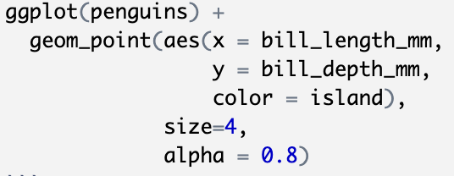
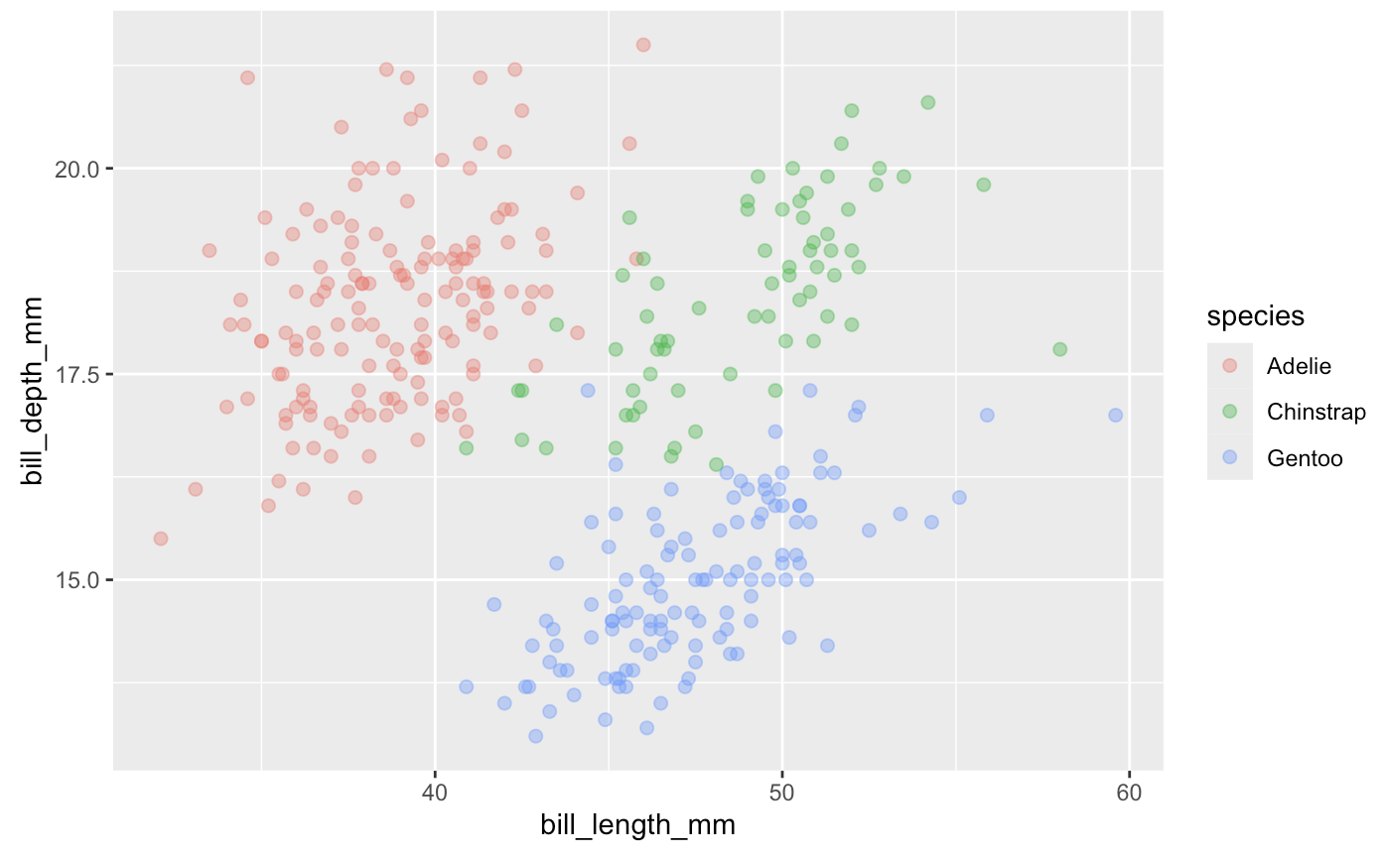
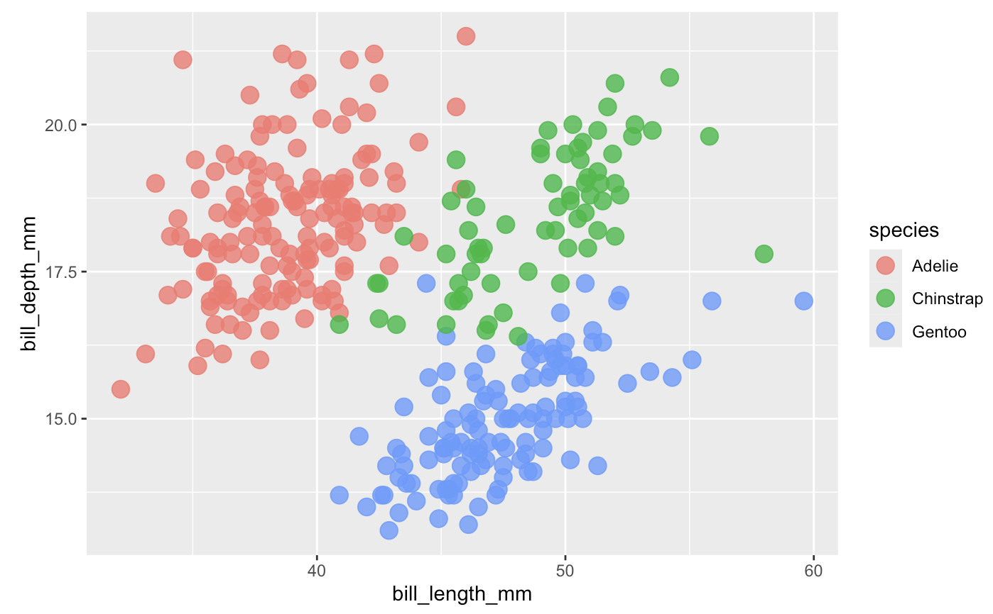
How to change size of points and transparency
Transparency:
alpha = number between 0 (completely transparent) and
1(completely opaque)
Size of points: size

Slide 27
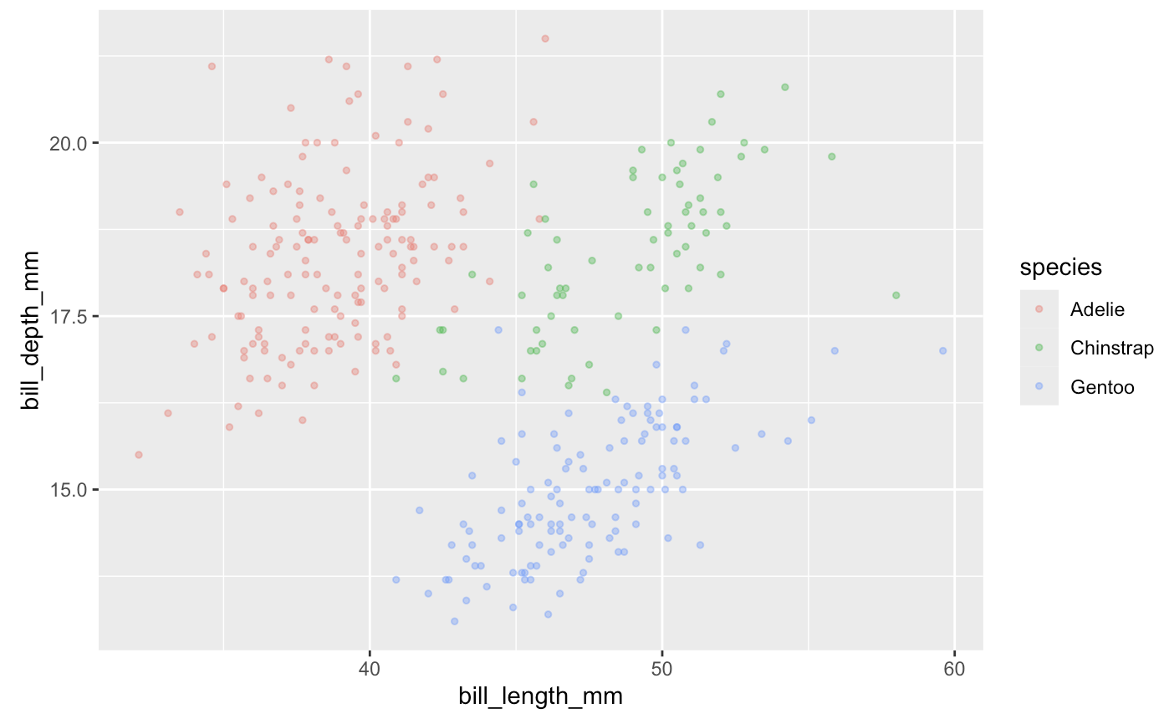
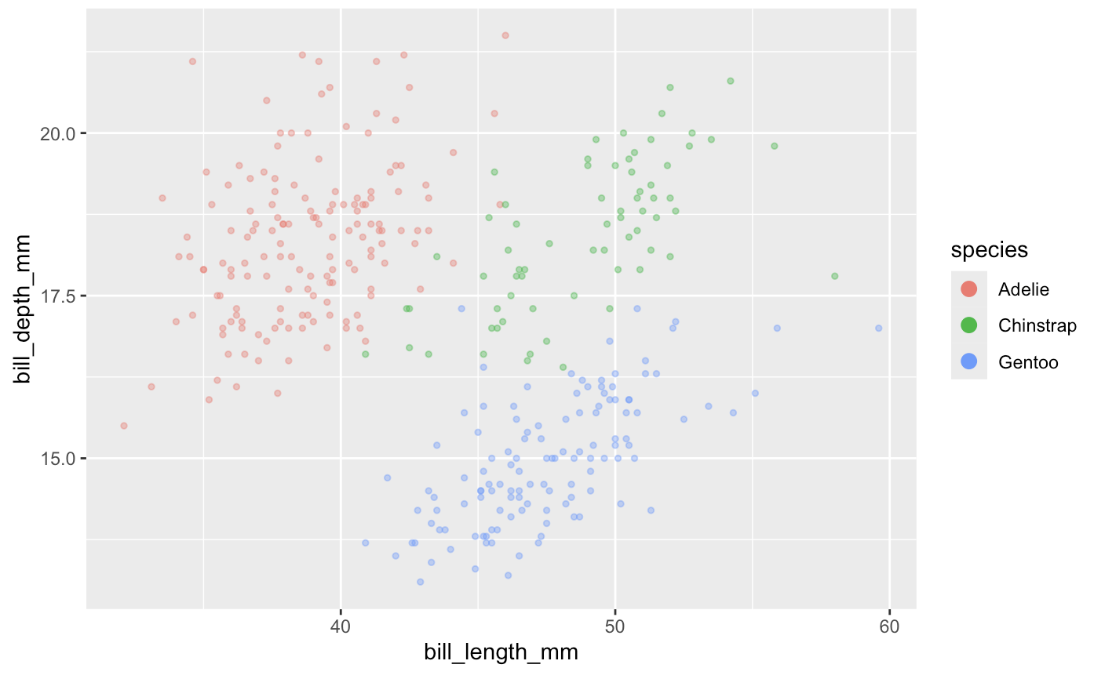
Adjust the appearance of the legend
+ guides(color = guide_legend(
override.aes = list(size = 3, alpha = 1))
)

Slide 28
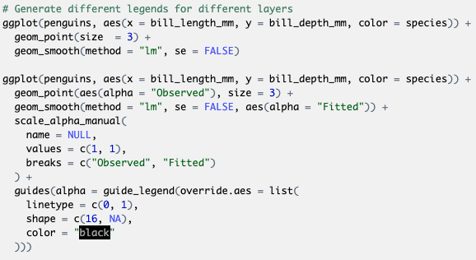
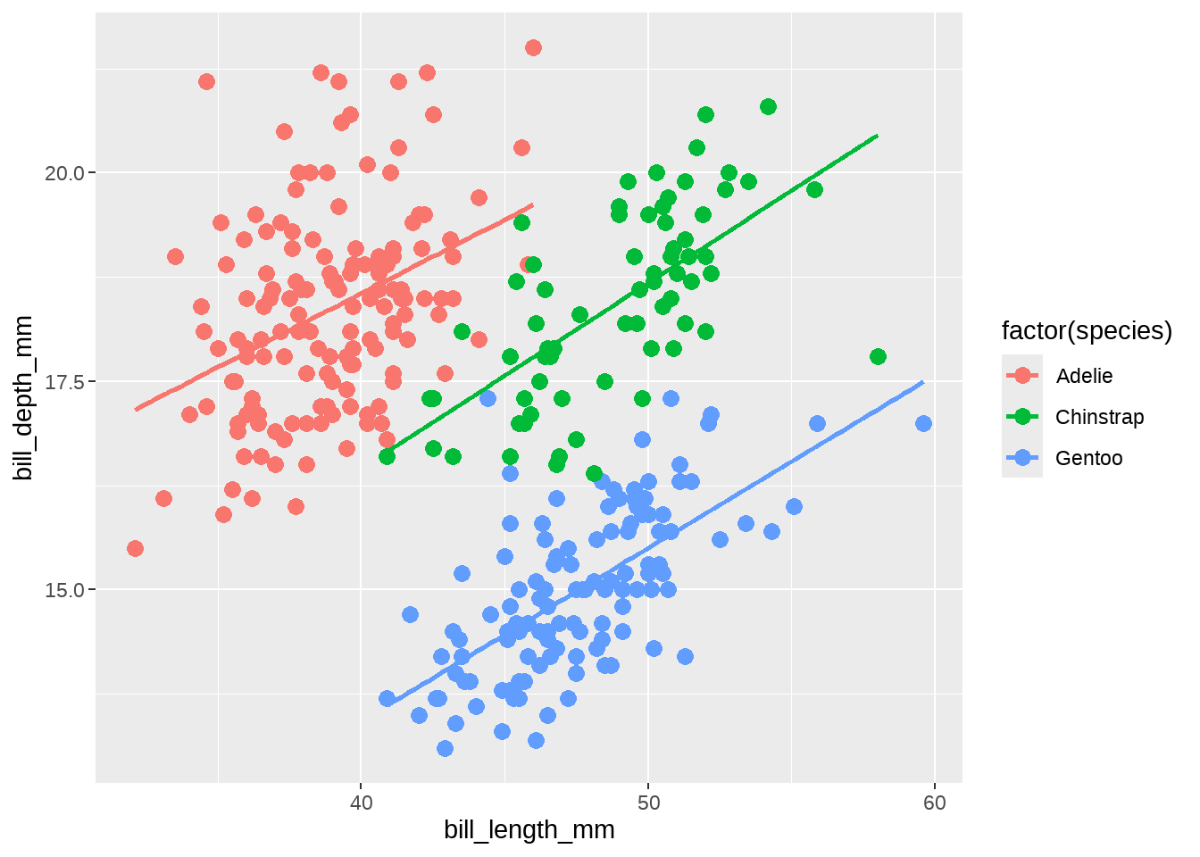
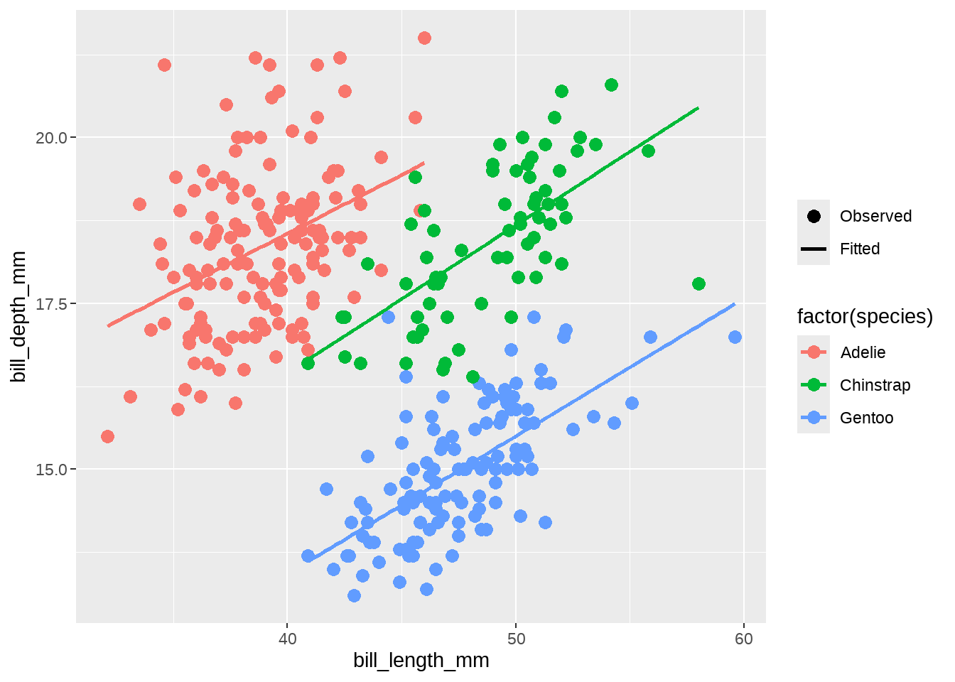
Generate different legends for different layers
How to add a legend to illustrate the original observations and the fitted line？

Slide 29
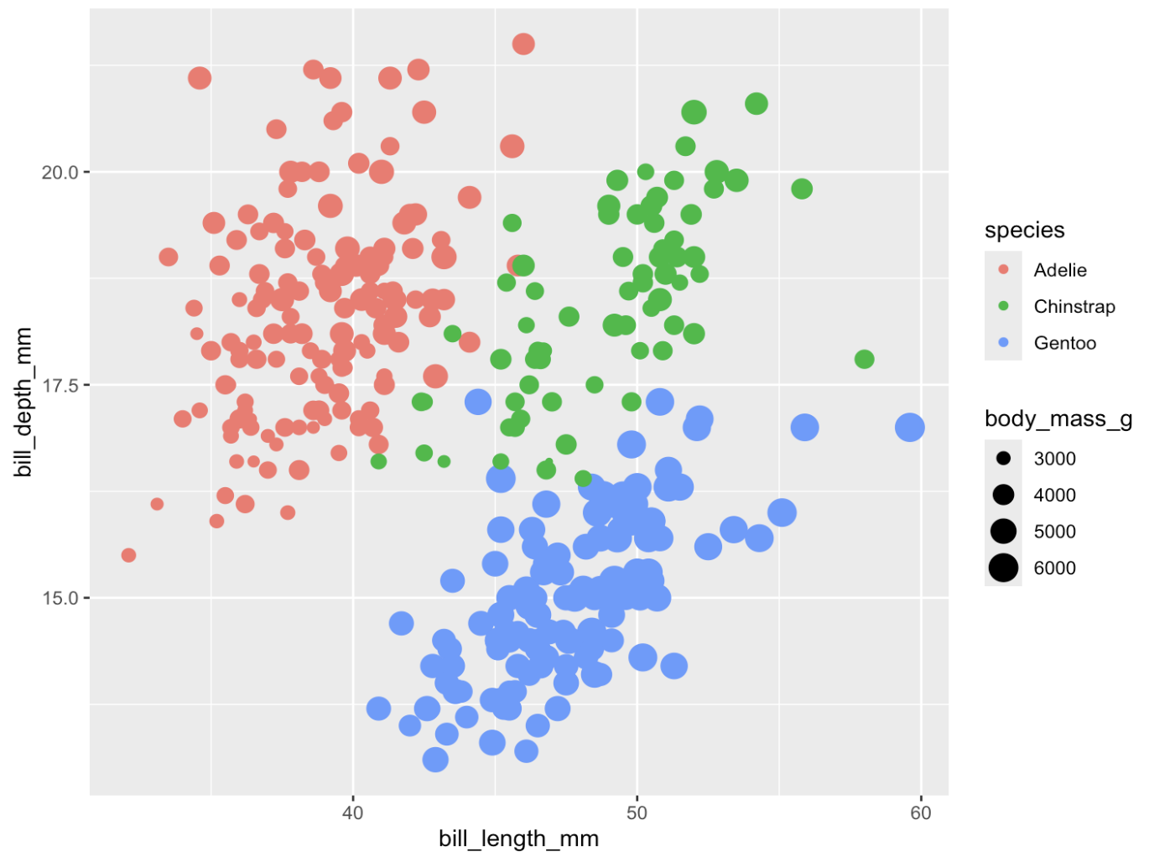
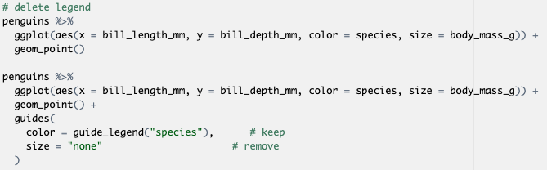
Delete the legend

Slide 30
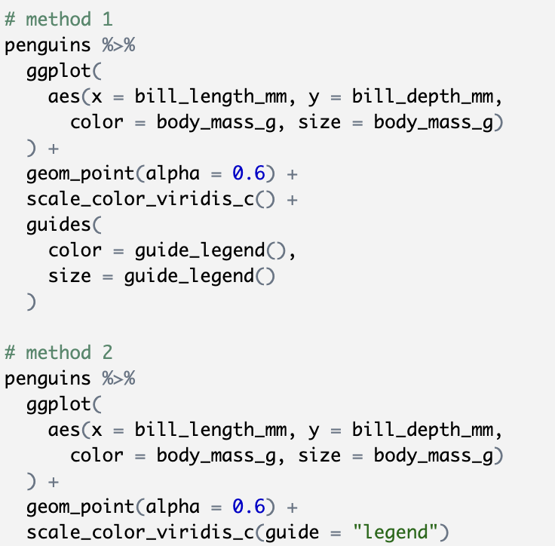
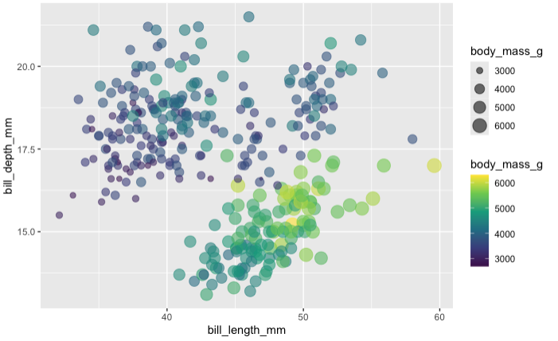
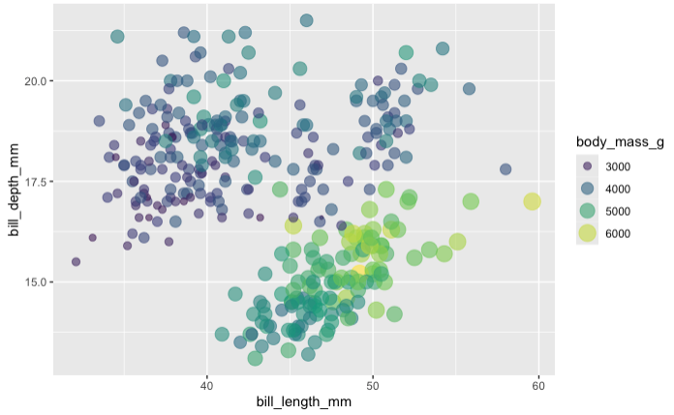
Merge the legend

Slide 31
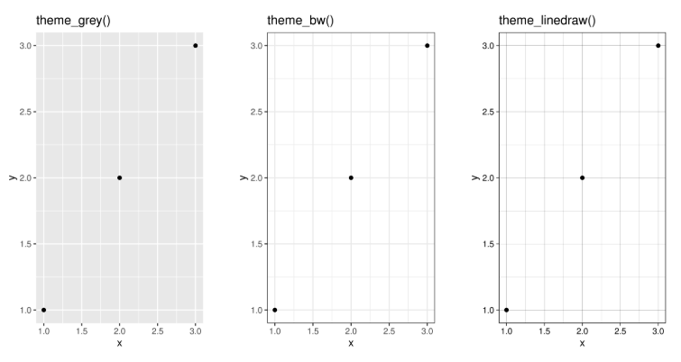
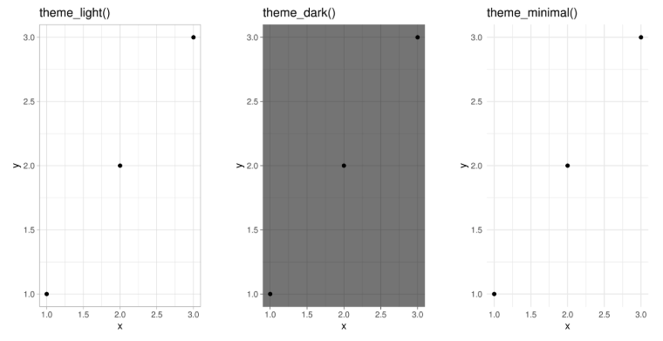

Theme
df <- data.frame(x = 1:3, y = 1:3)
base <- ggplot(df, aes(x, y)) + geom_point()
base + theme_grey() + ggtitle("theme_grey()")
base + theme_bw() + ggtitle("theme_bw()")
base + theme_linedraw() + ggtitle("theme_linedraw()")
base + theme_light() + ggtitle("theme_light()")
base + theme_dark() + ggtitle("theme_dark()")
base + theme_minimal() + ggtitle("theme_minimal()")
base + theme_classic() + ggtitle("theme_classic()")
base + theme_void() + ggtitle("theme_void()")

Slide 32

Exercise 1 (10 mins)
Improve the plot based on the following requirements
Improving the axes and legend labels
Adding a title for the plot
Tweaking the color scale to your favorite palette
The background should be white, not pale grey
Major gridlines should be a pale grey and minor gridlines should be removed
The plot title should be centered in 12pt bold text

Slide 33
Specialized Plot

Slide 34

Heatmap
Base R: heatmap() Function
ggplot2 with geom_tile()
pheatmap for Annotated Heatmaps
Correlation analysis
Feature importance in Machine Learning
Geospatial data
Gene expression data in biology
Resource utilization
Data quality checks
Comparing performance metrics
Cluster analysis
Useful materials: https://r-graph-gallery.com/215-the-heatmap-function.html

Slide 35

Kaplan-Meier curve
survival analysis
estimate the survival probability over time
“ggsurvplot()” from survminer library is a useful function to generate KM Curve using ggplot2

Slide 36

Manhattan plot
Used primarily in genome-wide association studies (GWAS) to visualize p-values across genomic positions.
Useful materials: https://r-graph-gallery.com/101_Manhattan_plot.html

Slide 37


2D density plot
A 2D density plot is a useful visualization to understand the distribution of data points over two continuous variables if you have a huge number of points.
geom_bin2d()
Useful materials: https://r-graph-gallery.com/2d-density-plot-with-ggplot2.html

Slide 38
Interactive Plot

Slide 39

?
What can you observe from this plot?
Do you have any questions about this plot?

Slide 40


Check the data
Any variable could be used to further explain this plot?
Species/ Island?
What if we are still interested in individual info?

Slide 41

Try ggplotly!
What if we are interested in which island the penguin lives or any other information?

Slide 42


Customize tooltip

Slide 43


More advanced customization
Use bold text to make the tooltip more readable
Add a title to the tooltip
Change the background color of the tooltip to white
Change the font color of the tooltip to black

Slide 44

Animate your figure
Try gganimate!
https://gganimate.com/

Slide 45
R Shiny Dashboard
Shiny is an R package used to build interactive web applications directly from R
Common use cases: data visualization, dashboards, interactive reports, and real-time data processing.
Structure: UI (User Interface) + server (backend logic)
UI design: fluidPage(), sidebarLayout(), ……
Shiny is reactive, which means that inputs trigger changes in the outputs

Slide 46
Let’s first see an example of R shiny dashboard to analyze Omics Data - GraphBio
http://www.graphbio1.com/en/

Slide 47


Skeleton of R Shiny
User interface (UI)
[define visual elements]
+
Server
[handle the reactive behavior and interactions]

Slide 48



Layout options: Layout/Panel
SidebarLayout
TabsetPanel

Slide 49

Placeholders
Define a placeholder for plots, tables, and text in the user interface and server side.
Plot
Table
Text

Slide 50

Control Widgets
Allow users to interact with the app
Text box
Numeric input
Slider
Range selector
Radio button
Dropdown menu (single selection/multiple selections)
Checkbox
……
More widgets: https://shiny.posit.co/r/gallery/

Slide 51

Let’s work on a simple R shiny demo!

Slide 52



How to arrange shiny in multiple pages
Use dashboardPage() from shinydashboard package in UI! Another choice: navbarPage()
Check “3_ShinyDemo.R” to see how to combine “1_ShinyDemo.R” and “2_ShinyDemo.R” into one Shiny app.

Slide 53
Exercise 2 (15 mins)
Please select one of the example plots and use ggplotly to make it interactive. If you have time, try to create your own R shiny dashboard!

Slide 54



Friends don’t let friends make bad graphs
Don’t make violin plots for small sample sizes
Don’t make heatmap without checking outliers
Don’t use red/green and rainbow color scales
……
https://github.com/cxli233/FriendsDontLetFriends

Slide 55
Useful resources
ggplot2:
Elegant Graphics for Data Analysis (3e) https://ggplot2-book.org/
https://ggplot2.tidyverse.org/reference/
More about data visualization in R (including code, very useful!)
https://r-graph-gallery.com/
Fundamentals of Data Visualization:
https://clauswilke.com/dataviz/
Friends don’t let friends make bad graphs:
https://github.com/cxli233/FriendsDontLetFriends
R shiny:
https://shiny.posit.co/r/gallery/
https://shiny.posit.co/r/getstarted/shiny-basics/lesson1/
https://bookdown.org/weicheng/shinyTutorial/
https://www.appsilon.com/post/r-shiny-in-life-sciences-examples

Slide 56








Coffee Break & Networking Session
Workshop Sponsors

